Slide 1

Quercus Activity and First-Year Retention
Presenter: Amanda Ng, Aria Hu, Carrie Zheng
TA: George Stefan
Collaborator: Jeff Burrow
Slides prepared solely be Amanda

Slide 2
Overview
01
Introduction
Motivation
Research Question
Study Implication
02
Data Overview
Data Source
Variables
EDA
03
Analytic Approach
Statistical Models
Justification
04
Key findings
Model results + interpretation
Metric evaluation
Limitations
05
Conclusions
Conclusion
Recommendation

Slide 3
Introduction
Notes:
2- 2.5 mins max

Slide 4
Introduction
Introduction
Data Overview
Analytic Approach
Key findings
Conclusion
👀 Motivation
Individuals without a post-secondary degree -> lower earnings
Retaining 1% more students -> $ 3 million tuition revenue
📌 Research Objective
Investigate the association between students’ engagement patterns in Quercus and their likelihood of dropping out
🌟 Study significance
Inform interventions, such as assigning college registrars to conduct early outreach to support at-risk students

Slide 5
Data Overview
Notes:
3.5-4 mins max

Slide 6
Data Sources
Introduction
Data Overview
Analytic Approach
Key findings
Conclusion
1. Quercus Records Store (QRS)
Source: University of Toronto’s Learning Management System (LMS)
Data Tracked: Whether Quercus was accessed on a given day
Update Frequency: Daily
Note:
No details on specific interactions or timestamps
Excludes students who never accessed Quercus during the term
2. Institutional Retention Database
Source: University of Toronto’s retention tracking system
Data Tracked: Students’ second-year retention status, academic performance, and demographics
Update Frequency: Annually (November 1st)

Slide 7
Data Recap
Introduction
Data Overview
Analytic Approach
Key findings
Conclusion
👥 Participants: 2022-2023 UofT First year students
📊 Sample size: 3299 (after cleaning)
🔭 Observation window: 1 Sep 2022 - 7 Dec 2022
📝 Relevant Variables:
Year 2 Inactive indicator
Incoming GPA before students began at UofT
Gender
Immigration category
First Term Course Count as of November 4, 2022
Daily Quercus visit indicator ⇒ to be transformed
Year 1 cGPA
Year 1 Final Standing
Response variable
Baseline demographic predictors
Quercus engagement predictors
Not included as predictors

Slide 8
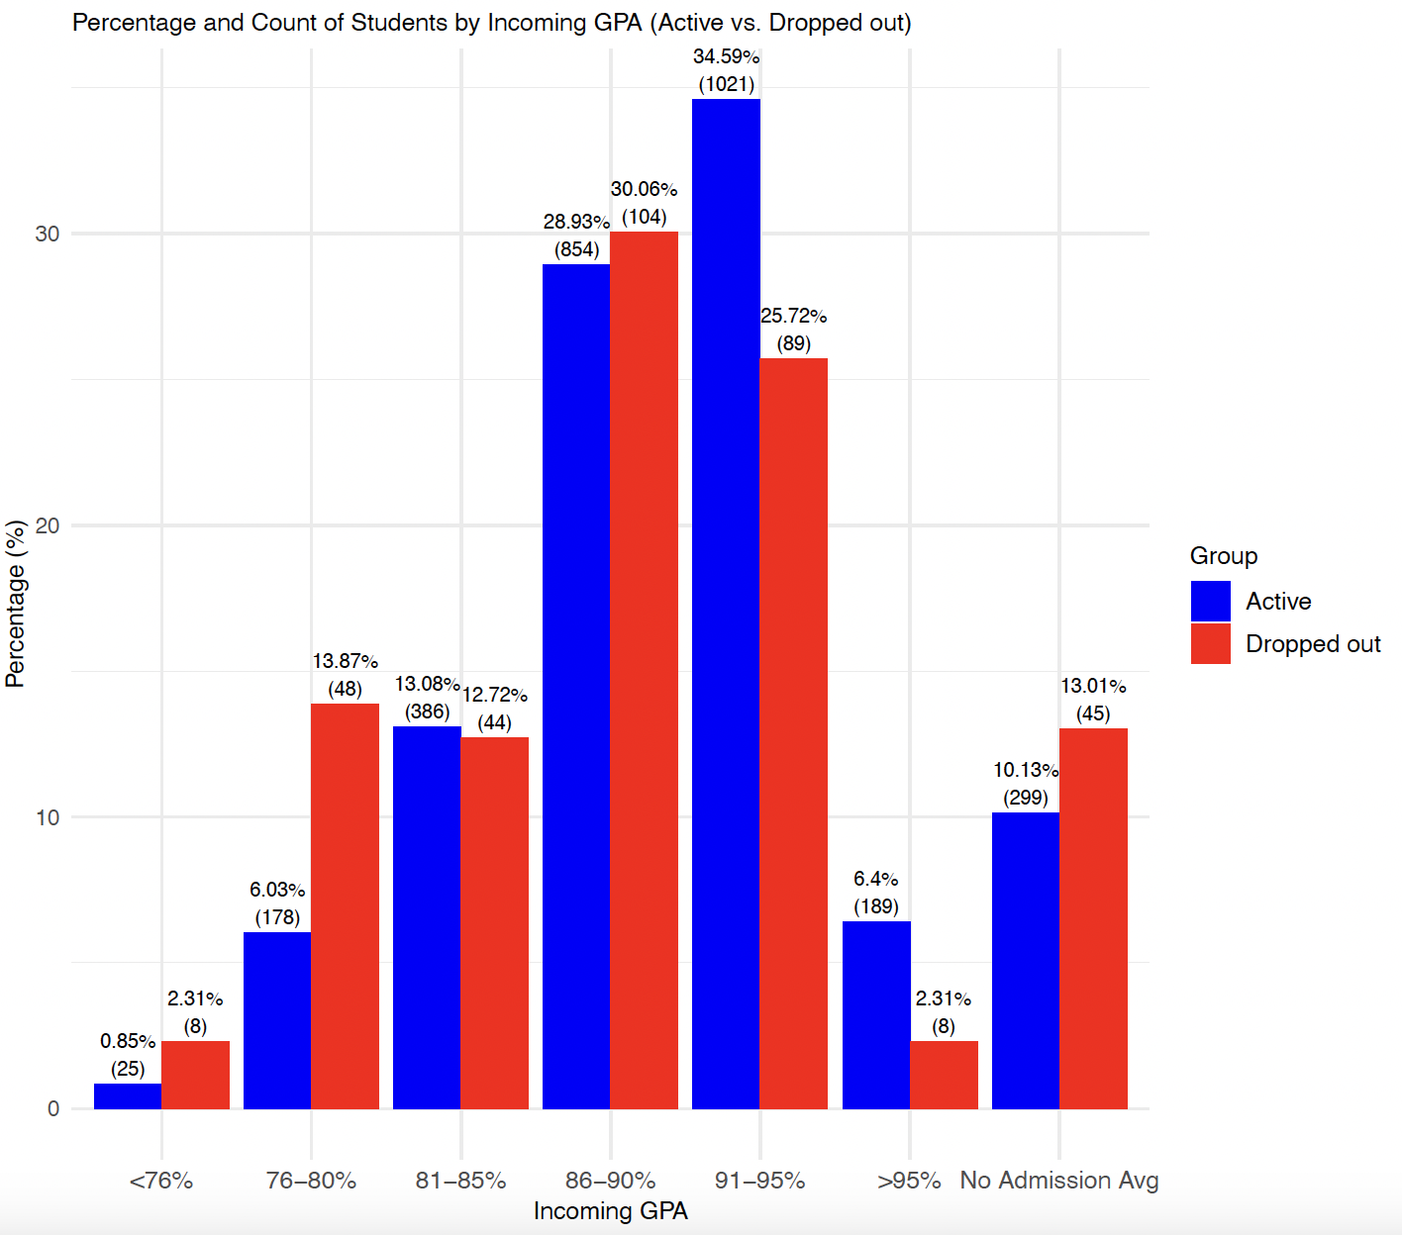
EDA: Incoming GPA
Introduction
Data Overview
Analytic Approach
Key findings
Conclusion
Majority bucket
Active: 91-95%
Dropout: 86-90%
> 95% bucket
2.84 times higher among active students
Greater proportion of students in lower GPA buckets among dropouts

Slide 9
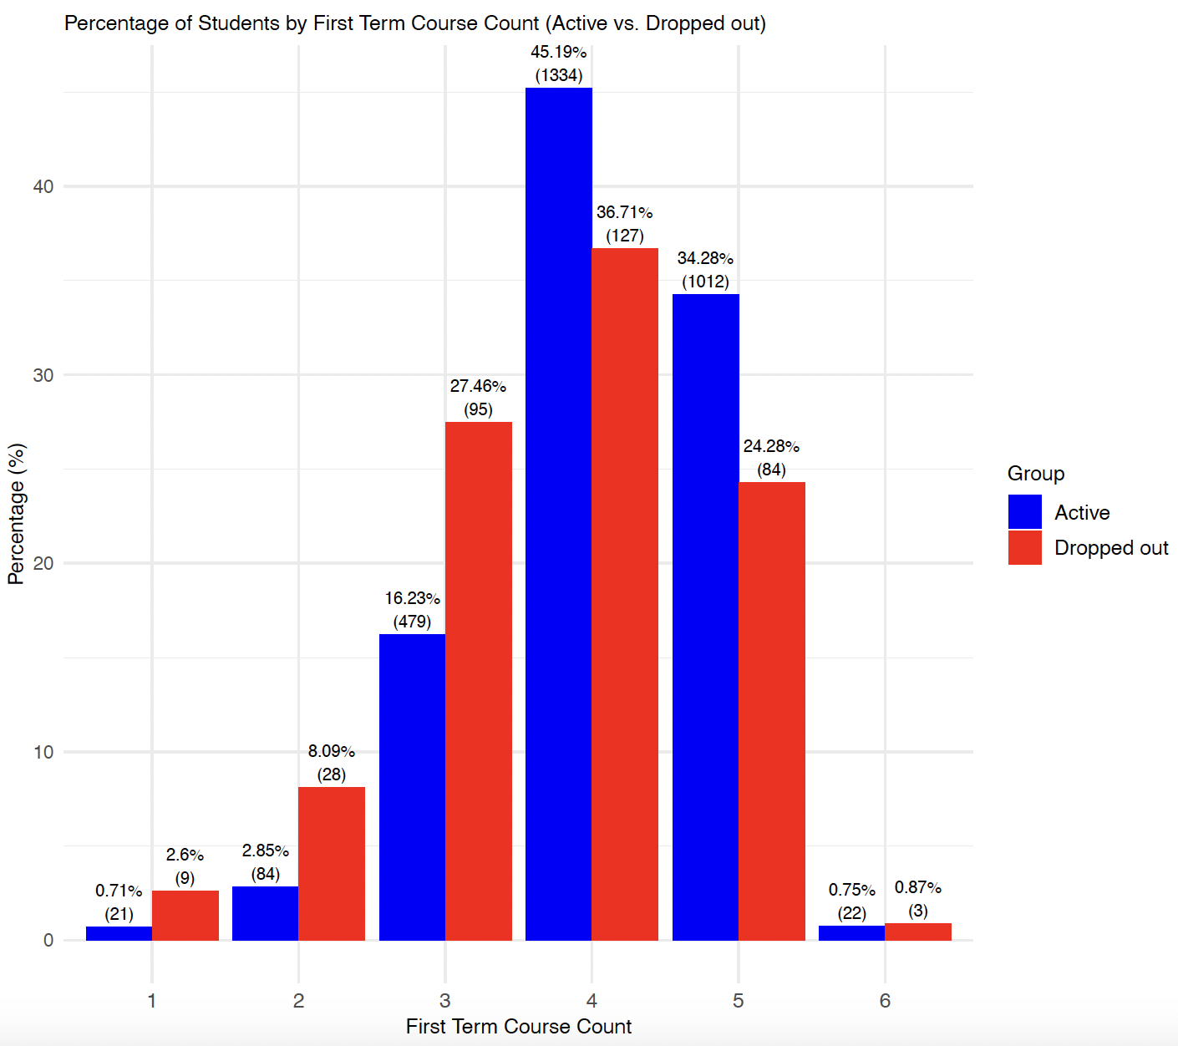
EDA: First term course count
Introduction
Data Overview
Analytic Approach
Key findings
Conclusion
Active:
Majority: 4, 5 courses
Tails at lower and higher counts
Dropout
More evenly spreaded
Higher percentages at lower course counts

Slide 10
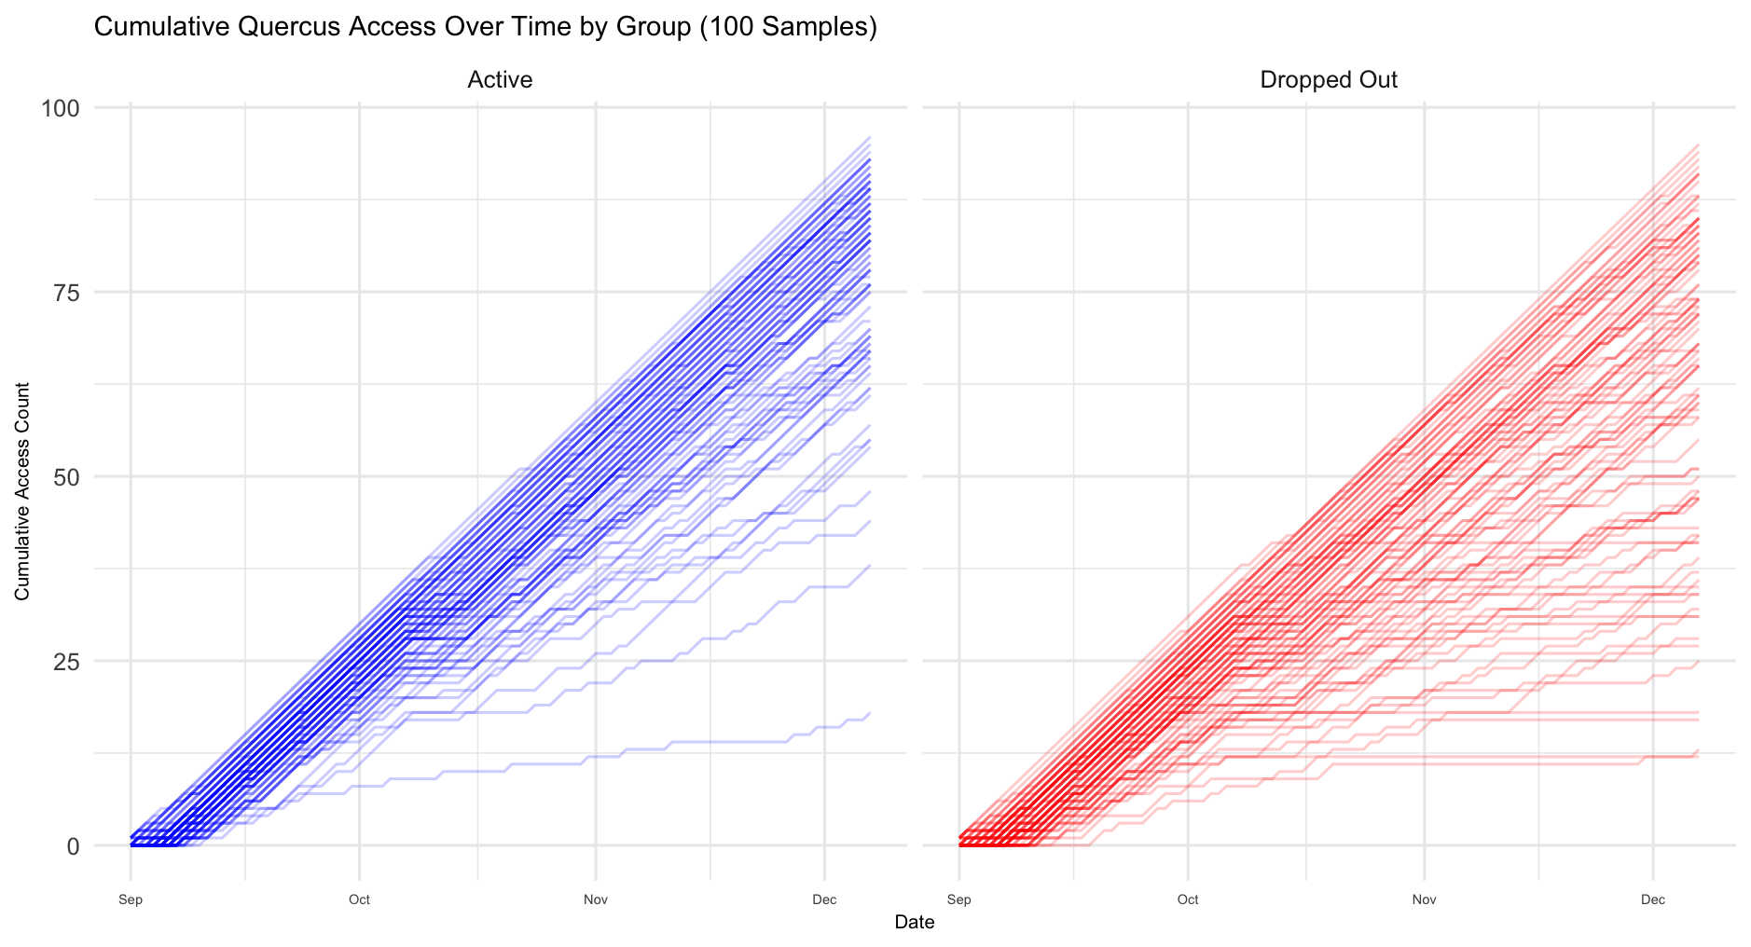
EDA: Quercus engagement
Introduction
Data Overview
Analytic Approach
Key findings
Conclusion
Active:
Tightly clustered lines
More consistent and uniformly high engagement
Dropped out:
More variability
Lower or irregular engagement
Notes:
Observe differences in trends between the two groups
X-axis: time (by day)
Y-axis: cumulative quercus visit count
Each line represents one student, horizontal period refers to non-engaging period

Slide 11
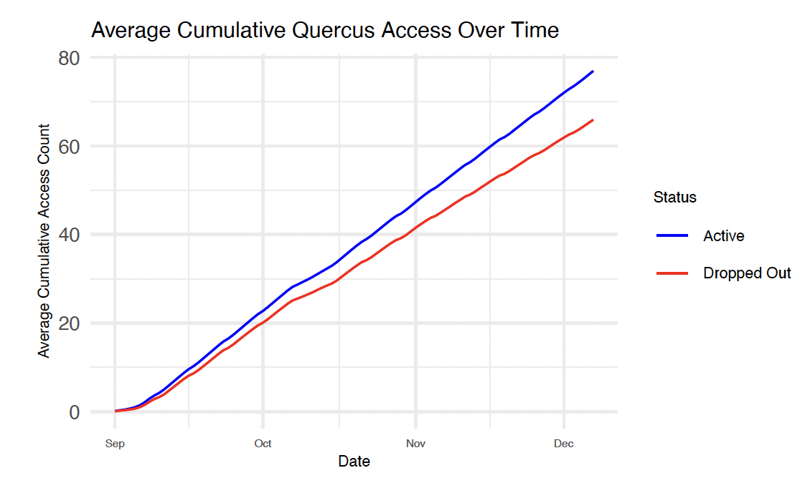
EDA: Quercus engagement
Introduction
Data Overview
Analytic Approach
Key findings
Conclusion
Active:
Steeper trajectory
Sustained or increasing engagement over time
Dropped out:
Flatter trajectory
Lower or declining engagement over time

Slide 12
Analytic Approach
Notes:
2.5 mins max

Slide 13
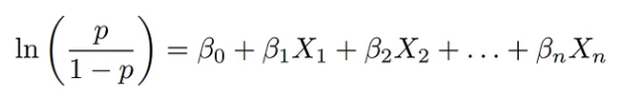
Statistical Model
Introduction
Data Overview
Analytic Approach
Key findings
Conclusion
Logistic regression model
Linear combination of predictors
Predictors:
Standardized cumulative Quercus visit counts
Incoming GPA
Gender
Immigration category
First term course count
Fitted outcome: logit of dropping out
*70:30 train-test split

Slide 14
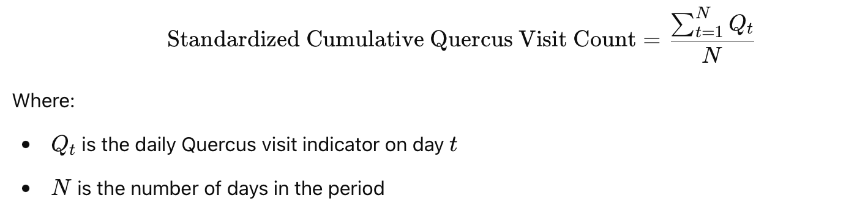
Standardized Cumulative Quercus Visit Counts
Introduction
Data Overview
Analytic Approach
Key findings
Conclusion
Periods considered:
W1 - W4 (28 days): Before the midterm season
W1 - W8 (56 days): Mid-term season
W1 - W12 (84 days): Post mid-term
W1 - W15 (98 days): Full fall term
4 new Quercus visit variables

Slide 15
Justification of Models
Introduction
Data Overview
Analytic Approach
Key findings
Conclusion
Why LR?
Longitudinal framework not feasible
Dropout can occur at any time, but exact timing is unknown.
Outcome at time t ~ Predictors at time t
Binary Outcome
Probability Estimation
Interpretability
Coefficients can be transformed into odds ratios
Non-Quercus predictors
Lower incoming GPA and lower course load ⇒ increase in the likelihood of dropping out
Gender and immigration category ⇒ capture underlying factors such as differences in access to resources, cultural adjustment, or language barriers

Slide 16
Justification of Models
Introduction
Data Overview
Analytic Approach
Key findings
Conclusion
Standardized Cumulative Quercus Visits
Why cumulative?
Avoid Multicollinearity
Interpretation issue
Why standardized?
Longer windows naturally accumulate to higher counts
Ensures fair comparisons across different time periods
Models using different visit count windows
Determine predictive power based on information available in shorter/longer period
Possibly intervening sooner
Similar predictive powers are observed from short-term (W1–W4) and long-term (W1–W15) models
Analyze dropout risk without waiting for full-term data.

Slide 17
Key Findings

Slide 18
Interpretation of Model results
Introduction
Data Overview
Analytic Approach
Key findings
Conclusion
Baseline scenario
Female domestic student with incoming GPA less than 76%, enrolled in only 1 course during fall term and has never visited Quercus within the specified period.
Exponentiated beta coefficients
Odd ratios (OR) of dropping out for “one unit” increase in the predictor
Categorical non-Quercus indicators
OR of dropping out for the indicator category in the predictor compared to baseline category given other predictors hold constant
Quercus visit predictor
Proportion: “one unit” increase does not make sense
Multiply by fraction of window length (e.g. 10%) = OR of dropping out if a student visited Quercus for 10% more days during the window

Slide 19
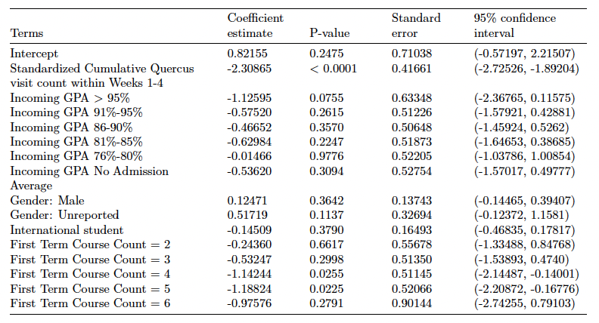
W1 - W4 Model results
Introduction
Data Overview
Analytic Approach
Key findings
Conclusion
Number of days during W1-W4
= 28
OR of additional day visit during W1-W4
= exp(-2.31*1/28)
= 0.92

Slide 20
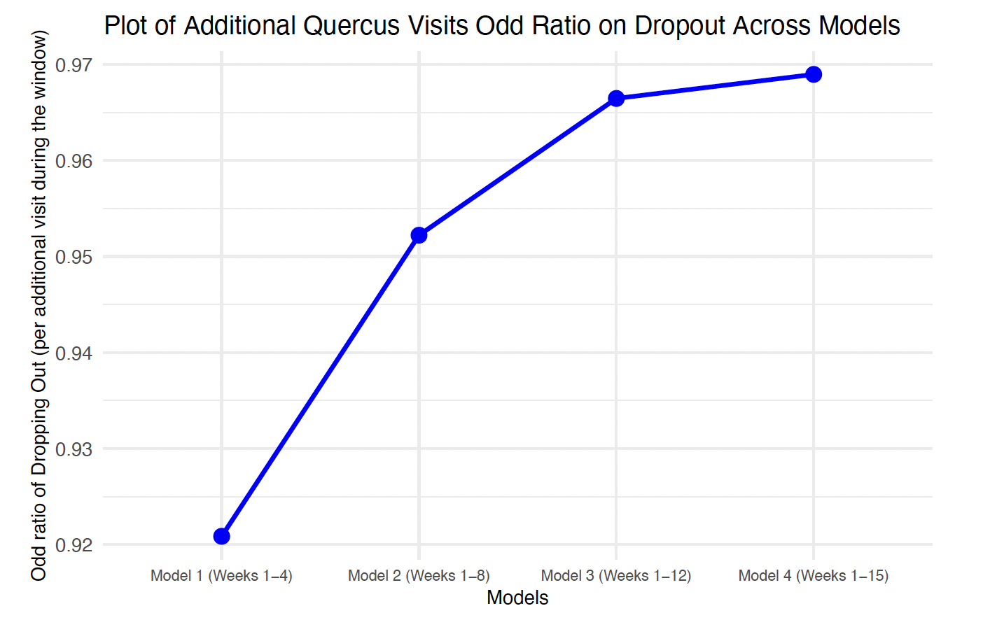
Comparison of additional Quercus visit effect
Introduction
Data Overview
Analytic Approach
Key findings
Conclusion
As window length increases, one additional quercus visit leads to OR closer to 1
More similar odds to drop out compared to without additional Quercus visit.
Increase quercus visit in earlier period is more effective in lowering the dropout risk

Slide 21
Model evaluation metrics
Introduction
Data Overview
Analytic Approach
Key findings
Conclusion
Different thresholds
Output of LR model = drop-out probability
Cut off probability to classify a student into the drop out group
Sensitivity (TPR)
Ability to correctly identify students who actually drop out.
Specificity (TNR)
Ability to correctly identify students who did not drop out.
Misclassification rate
Proportion of all incorrect predictions (FP+FN)

Slide 22
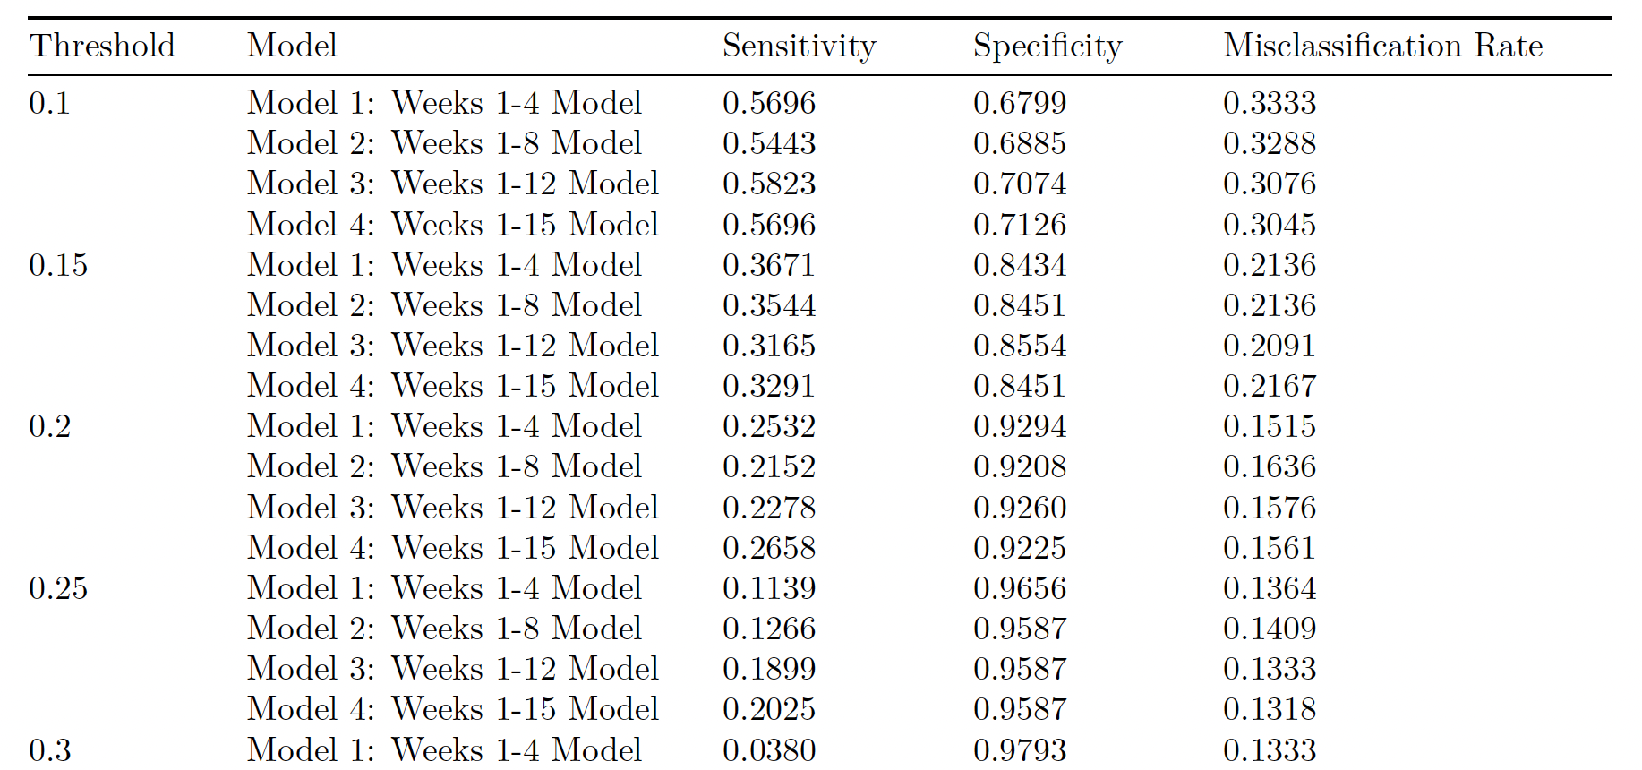

Evaluation metric results
Introduction
Data Overview
Analytic Approach
Key findings
Conclusion
Similar
👍
👎
👎
👎
👍
👍

Slide 23
Limitation
Introduction
Data Overview
Analytic Approach
Key findings
Conclusion
Issue | Description
⚠️ Non-longitudinal | Does not capture probability changes over time
⚠️ Data Imbalance | Active = 584 vs Dropped out = 76 “All-negative-prediction model”: misclassification rate ~11.97% Final models demonstrated worse misclassification rates
⚠️ Low Sensitivity | Struggles to correctly predict students who are at risk of dropping out Hinders the opportunities to offer support to “missed” students before they disengage

Slide 24
Conclusion
Notes:
We have some lingering questions about our model and would like to collect some suggestions from you.

Slide 25
Conclusion
Introduction
Data Overview
Analytic Approach
Key findings
Conclusion
Quersus Engagement is a Strong Factor
EDA: Lower or irregular usage patterns observed among dropout students.
Model: significant predictor
Critical First Four Weeks
Demographic & Academic Factors
Male, domestic, incoming GPA < 76%, taking fewer first-term courses
Note: limited predictive power compared to Quercus engagement
Limited sensitivity

Slide 26
Recommendation
Introduction
Data Overview
Analytic Approach
Key findings
Conclusion
Conduct feature selection
Elastic net/ LASSO/ StepAIC
Eliminate unimportant demographic predictors
Check if Quercus visit predictor will be eliminated
Further model validation
Independent dataset
E.g. different student cohort
Expand observation window
Full-year Quercus engagement data
End-of-year predictors (Year 1 CGPA and final academic standing)
Provides academic support during the summer

Slide 27


Slide 28
Supplementary Slides

Slide 29
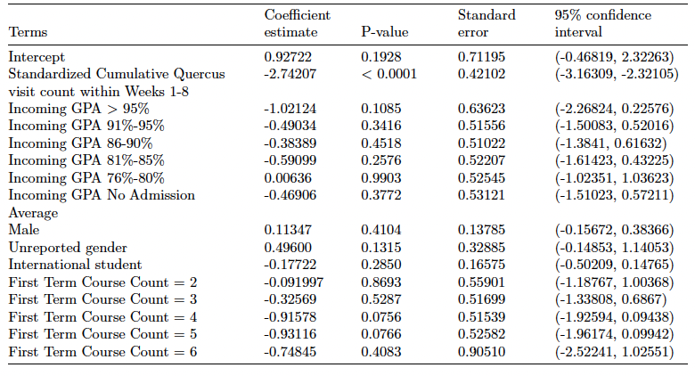
W1 - W8 Model results
OR of additional day visit during W1-W4
= exp(-2.74*1/56)

Slide 30
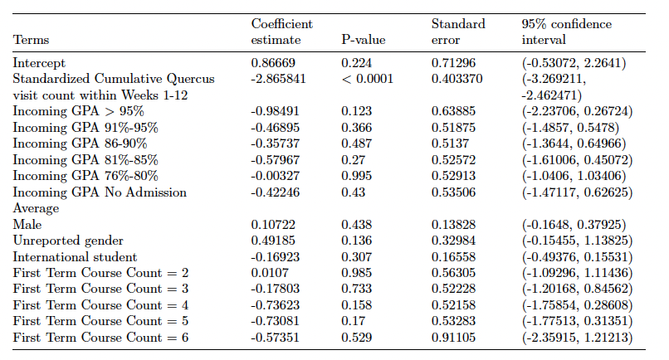
W1 - W12 Model results
OR of additional day visit during W1-W12
= exp(-2.87*1/84)

Slide 31
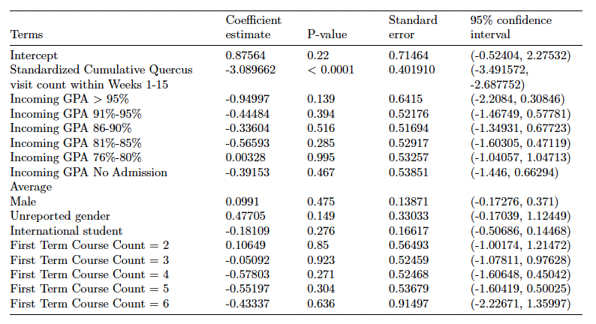
W1 - W15 Model results
OR of additional day visit during W1-W15
= exp(-3.09*1/98)

